Slide 1
The art of Reverse Engineering and Exploitation

Slide 2
whoami
CTF player
Member of CTF Academy, ASU
Member of TamilCTF
Yellow Belt at pwn.college
Cats

Slide 3


Slide 4
Before we start
Reversing and binary exploitation is a very broad topic, I am going to assume some basic knowledge.
If something doesn’t make sense, please don’t hesitate to ask.
First, some theory…

Slide 5
Reverse Engineering
The typical process of “making” a program:
Figure out what you want to code
Code it
Compile it
Run it
Information is lost in every step of the process.

Slide 6
Reverse Engineering
Transition between design and code:
Who wrote this bad code? …
Oh wait that was me
Transition between code and compilation:
Comments
Variable/function names
Structures
Algorithms (compiler optimization)

Slide 7
Reverse Engineering
The goal is to reverse the design of the binary:
Disassemble
Decompile
Lots of inference
understanding

Slide 8
What is cat?
$ file /bin/cat
/bin/cat: ELF 64-bit LSB pie executable, x86-64, version 1 (SYSV), dynamically linked, interpreter /lib64/ld-linux-x86-64.so.2, BuildID[sha1]=b357ed53c8c9cb1a312f83b28982304effae0135, for GNU/Linux 3.2.0, stripped
Windows has PE (Portable Executables), you might know them as exe’s.

Slide 9
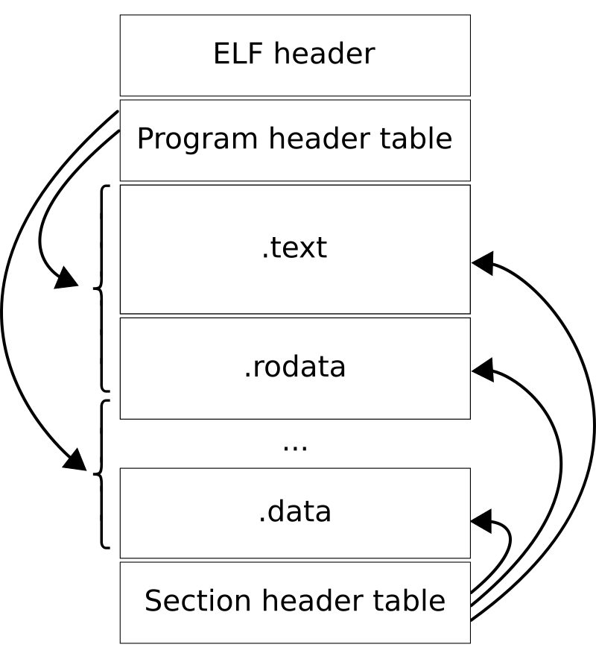
What is ELF?
Important sections:
.text - the executable code of your program
.rodata - global read-only data
.data - global writable data
.plt and .got - resolve and dispatch library calls

Slide 10
A basic introduction to assembly
Assembly is the simplest programming language.
It is also a direct translation of binary code and hence is very CPU architecture dependent.
X86
Arm
MIPS
RISC-V

Slide 11
Assembly Dialects
In the beginning intel created the 8085 CPU,
Then the intel 8086 CPU
Intel 80186 CPU
Intel 80286 CPU
Hence the name x86…
Now AT&T came along and made their own syntax for x86, a very terrible one.
Please stick to the intel syntax.

Slide 12
Registers
CPUs need to be fast, hence registers.
Rax,rbx,rcx,rdx,rbp,rsp,rdi,rsi,r8,r9,r10,r11,r12,r13,r14,r15
Most registers hold 64 bits of data (8 bytes) on a 64 bit system(obviously),
32 bit registers: eax,ebx,ecx….

Slide 13
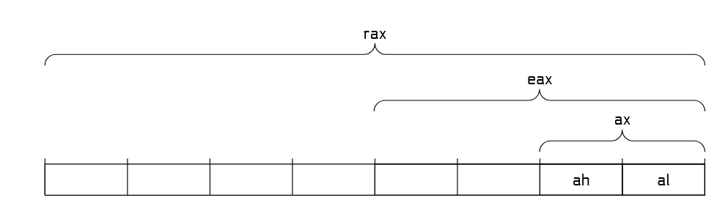
Partial access
This is to maintain backwards compatibility with older code.
(older systems used 32 bit registers).

Slide 14
Common instructions
add,sub - self explanatory
lea - load effective address (load address from memory)
mov - move data between registers or register and memory
call - calls a function
cmp - comparing two registers
jmp,jnz,jne,je,jz - control flow (jump)

Slide 15
Data access
Load: mov rax,[rip+offset]
Store: mov [rip+offset],rax
Reference: lea rax,[rip+offset]
On the stack:
Uses rbp or rsp
Eg: mov rax,[rbp-offset]

Slide 16

Syscalls!
https://codebrowser.dev/glibc/glibc/sysdeps/unix/sysv/linux/_exit.c.html

Slide 17
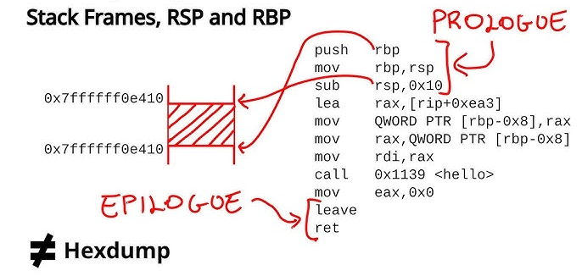
Functions
All functions begin with a prologue and end in a epilogue

Slide 18
Breaking down the program
A program is made up of modules
That implement certain functions
That contains blocks of instructions
That operate on variables and data structures

Slide 19
Tools
gcc - to make your binary
objdump - disassemble source code
objcopy - replace sections of binary
strip - remove debug symbols
strings - prints ASCII (readable) words from binary.
Ida,ghidra, binary ninja,radare2 - advanced disassemblers
strace - track system calls

Slide 20
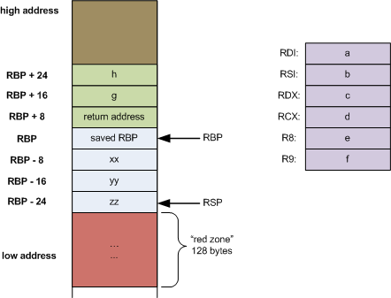
Functions frames
The stack maintains function frames that help keep track of program state(including variables,return addresses)

Slide 21
Lets get hands on
Let’s reverse a simple licence checker I made together.

Slide 22
Special cases
Any program compiled in a language that has an “intermediate” form will be easy to reverse and will have tools, eg:
.NET binaries compiled on windows(.NET runtime)
Python and Java (uses a VM to execute code)

Slide 23
What's the point
In order to exploit a program, we need to understand it better than the developer who wrote it.
Keygens
Anti-Debugging
VMs
DRMs
Malware Analysis

Slide 24
The problem with C
C was designed to provide low level memory access to developers. It maps very closely to assembly with very few surprises.
Of course, with great power comes great responsibility.
A lot of software has been developed in languages with no memory safety.
By the time modern VM-based and memory safe languages were developed, it was already too late.

Slide 25
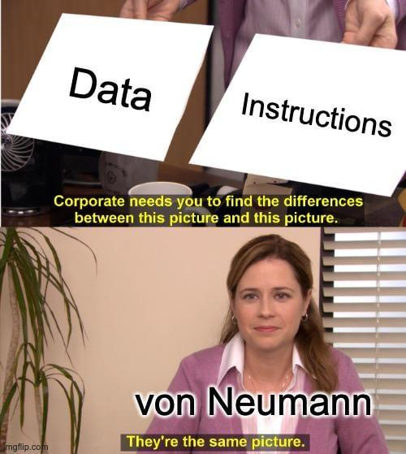
Binary Exploitation
The Von Neumann architecture

Slide 26
Mixing data and code
All data is treated the same by the program.
Problems occur when user input reaches regions of memory it shouldn't.
Smashing the stack for fun and profit
Volume Seven, Issue Forty Nine

Slide 27
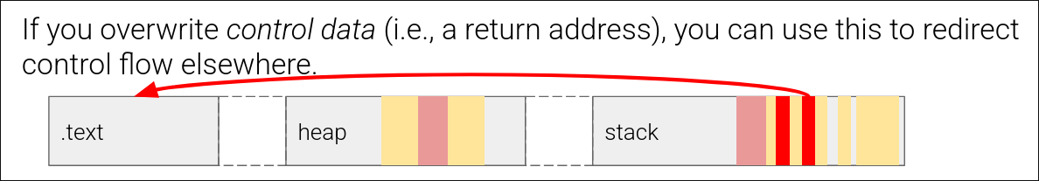
Ret2win example
Note that ASLR is enabled (this is the default setting and no one will go out of their way to disable it)

Slide 28
Ret2win
But now, let’s add a condition check… how do we bypass that?

Slide 29
ret2win?
What if there’s no win?
Shellcode!

Slide 30
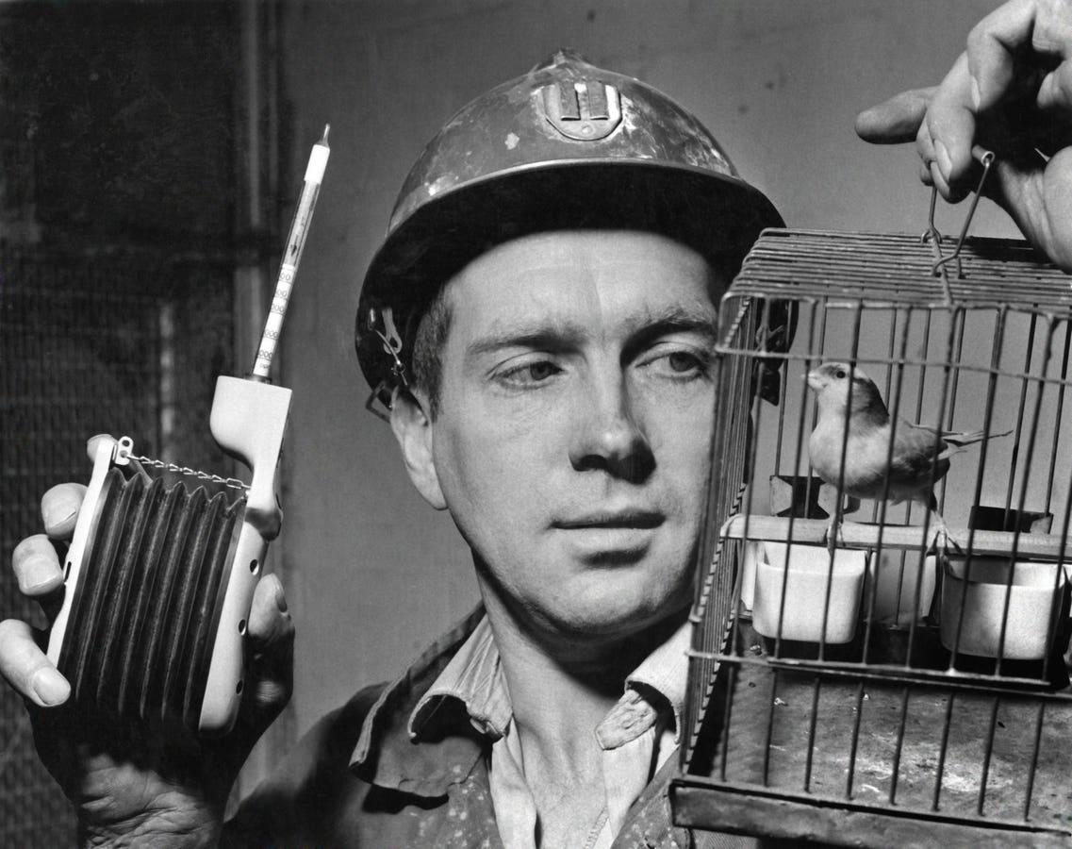
The canary

Slide 31
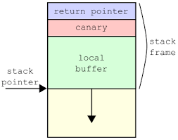
The canary
The canary is a special value that is placed on the stack at the start of the function, and checked at the end of it.

Slide 32
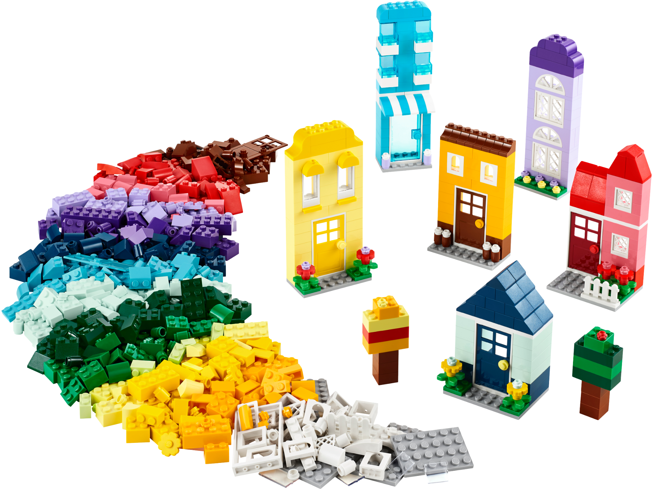
Lego Pieces

Slide 33
Bits and pieces
What if we have two useless functions that do something useful when combined together?
Let's look at an example.
A function that opens the flag file.
A function that reads from a file descriptor.
This is the basis of a concept called ROP, but instead of functions, we mess with instructions.

Slide 34
Modern Mitigations
ASLR - Address Space Layout Randomization
Will randomize the memory layout of a program during runtime. (stack,heap etc.)
PIE - Position Independent Executable
Will randomize the location of the binary’s executable code.
Usually PIE and ASLR and combined together.
cat /proc/sys/kernel/randomize_va_space

Slide 35
Modern Mitigations
NX - no-execute bit - makes the stack non-executable.
Relocation Read Only (RELRO) - another modern mitigation, will make the GOT/PLT table read only.

Slide 36
But my shellcode!
You may have noticed that the NX bit makes the stack non-executable. So shellcoding is not longer a viable option. It is still possible to exploit binaries that have all protections enabled.
Most modern exploits combine one or two(sometimes even more) vulnerabilities in order to do anything useful.

Slide 37
Defeating modern mitigations
Typically, one would need a leak of a memory address in order to get exploit a binary with ASLR/PIE.
Exception: fork()’d processes have the same canary and the same memory layout.
PIE binaries are usually page aligned… this has some implications.

Slide 38
Lego pieces
ROP is a technique using instructions from the binary to achieve the desired result. The instructions are generally in the form of:
[some operation], ret
These instructions are known as gadgets.
We can chain multiple gadgets like this and create a “ROP chain”

Slide 39
But wait there’s more…
GOT overwrite
Heap exploits are still a common occurence to this day… (A lot of it being tcache)
Race conditions
Sandbox escapes
Kernel exploitation

Slide 40
Weird Machines
“Any complex execution environment is actually many, one intended machine, endless weird machines”
An exploit is code that runs on a “weird machine” in its “weird instructions”.
https://langsec.org/papers/Bratus.pdf
https://www.youtube.com/watch?v=8Dcj19KGKWM

Slide 41
References and further reading
https://pwn.college
https://p.ost2.fyi/courses
https://gist.github.com/anvbis/64907e4f90974c4bdd930baeb705dedf
https://0xinfection.xyz/reversing/
https://play.picoctf.org/
https://quixel200.github.io/

Slide 42
Thank you

